Slide 1


Pitch Gym: AI-Powered Investor Simulation for Startup Pitch Training
Henil Diwan 22BCE3962
School of Computer Science and Engineering
Final Review
Project Guide: Dr. Sarwesh P
School: SCOPE

Slide 2

Synopsis
Pitch Gym - a web platform where founders practice investor pitches through real-time voice AI conversations and receive structured, quantitative feedback.
Key Features:
10 distinct pitch types covering various entrepreneurial scenarios: from Idea Validation to Investor Skeptic Mode
AI investor personas that ask probing questions, challenge assumptions, and behave like real investors
Structured per-category scoring (1–5) with identified strengths, weaknesses, and actionable improvement suggestions
Founder analytics dashboard with score trends, skill radar, and pitch type distribution charts
Context carry-forward: each session can build on prior feedback for progressive coaching
Credit-based monetization with Razorpay payment integration

Slide 3
PROBLEM STATEMENT
305M+ startups launched annually worldwide, yet over 90% fail
Poor investor communication is consistently cited as a leading cause of funding failure
Accelerator programs (YC, Techstars) accept fewer than 3% of applicants and are geographically concentrated
Human pitch coaches cost $200–500 per session with limited availability and subjective feedback
Text-based AI tools like ChatGPT and Claude can simulate investor conversations but cannot assess the verbal dimension such as tone, confidence, pacing, and the ability to think on one's feet
No existing solution combines real-time voice interaction, AI-driven investor simulation, structured quantitative scoring, and longitudinal progress tracking

Slide 4
EXISTING SOLUTIONS
Solution | What it Offers | Key Limitation
Accelerators (YC, Techstars) | Mentorship, Demo-Days, High- Quality | <3% Acceptance, Geographically Limited
Human Coaches | Personalised, Experienced Feedback | Very Costly Per Session, Subjective, Scarce
LLMs (GPT, Claude) | Interactive Investor Conversations | Text Only – No Verbal Delivery
Presentation Tools (Pitch.com, Beatiful.ai) | Professional Slide Design | Focus on Visuals and Presentations, Not Delivery
Video Recording Tools | Self-Review of Delivery | No Interactive Feedback/Questioning

Slide 5
OBJECTIVES
Build an AI-based pitch practice platform that simulates realistic investor interactions
Design and implement 10 distinct pitch scenarios, each with specialized system prompts and assessment criteria
Generate structured, quantifiable assessments from each session with per-category scores and actionable feedback
Enable progress tracking through an analytics dashboard with trend visualization
Implement context carry-forward so that each session builds on the founder's prior performance
Build a secure, fractional credit-based monetization system with server-side regulation

Slide 6
LITERATURE REVIEW
Title of the paper | Journal & Year | Authors | Description | Remarks
Systematic Review of AI in Higher Education | International Journal of Educational Technology, 2019 | Zawacki-Richter et al. | Reviewed 146 studies showing AI-assisted learning improves outcomes through personalization | Focused on text-based learning, not applied to verbal or interactive skills
The Impact of Entrepreneurs' Oral Pitch Presentation Skills on Business Angels' Initial Screening Investment Decisions | Venture Capital, 2008 | Clark, C. | Found that higher pitch presentation style scores directly increased the likelihood of business angel investment interest. Identified clarity, structure, persuasiveness, and entrepreneur personality as key factors in funding decisions. | Validates that verbal pitch delivery drives investment decisions
The Effectiveness of AI-Supported Personalized Feedback on Students' Learning Outcomes and Motivation: A Meta-Analysis | Journal of Educational Computing Research, 2026 | Wang, W., Wang, Y., Chen, J., Wang, X., Zhang, H., Guo, C., Peng, Y. | Meta-analysis finding AI-supported personalized feedback has a moderate effect on learning outcomes (g = 0.58) and strong effect on motivation (g = 0.82). | Confirms AI can deliver effective personalized feedback at scale

Slide 7
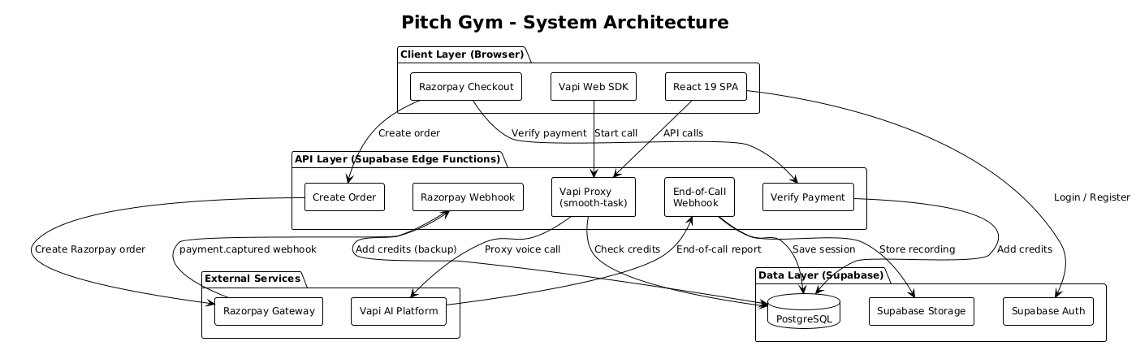
SYSTEM ARCHITECTURE

Slide 8
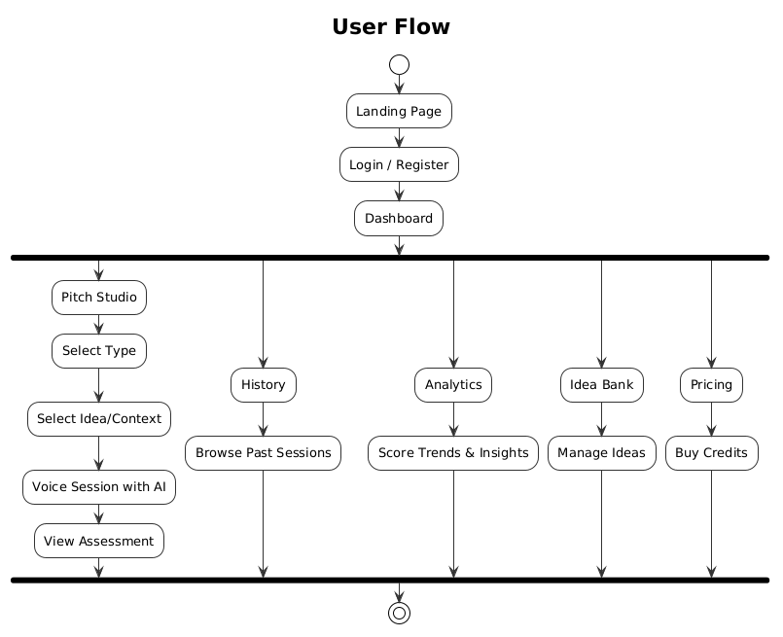
USER FLOW

Slide 9
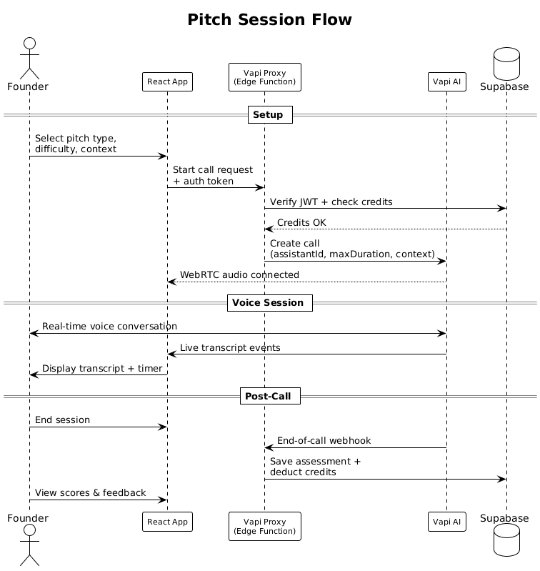
PITCH SESSION LIFECYCLE
Phase 1, Configuration: User selects pitch type, idea, and optional prior context
Phase 2, Call Setup: Edge Function authenticates user, checks credits, checks assistant type, calculates max duration, injects context, proxies to Vapi API. WebRTC audio session established.
Phase 3, Active Call: AI investor conducts realistic conversation. Live transcript displayed. Countdown timer with warnings at 2 min and 1 min.
Phase 4, Post-Call: Webhook extracts structured JSON assessment, stores audio recording, saves session to database, deducts fractional credits. Results page displayed.

Slide 10
PITCH TYPES
Sr. | Type | Key Skills Tested
1 | Idea Validation | Problem clarity, evidence, customer definition
2 | Elevator Pitch | Clarity, memorability, confidence
3 | VC Ready | Market sizing, traction, financials
4 | Product Feedback | Feature prioritization, user empathy
5 | Customer Discovery | Interview technique, assumption testing
6 | Technical Pitch | Architecture clarity, scalability vision
7 | Demo Day | Storytelling, time management
8 | Customer Pitch | Value proposition, objection handling
9 | Co-Founder Pitch | Vision alignment, role clarity
10 | Investor Skeptic | Pressure handling, composure, realism

Slide 11
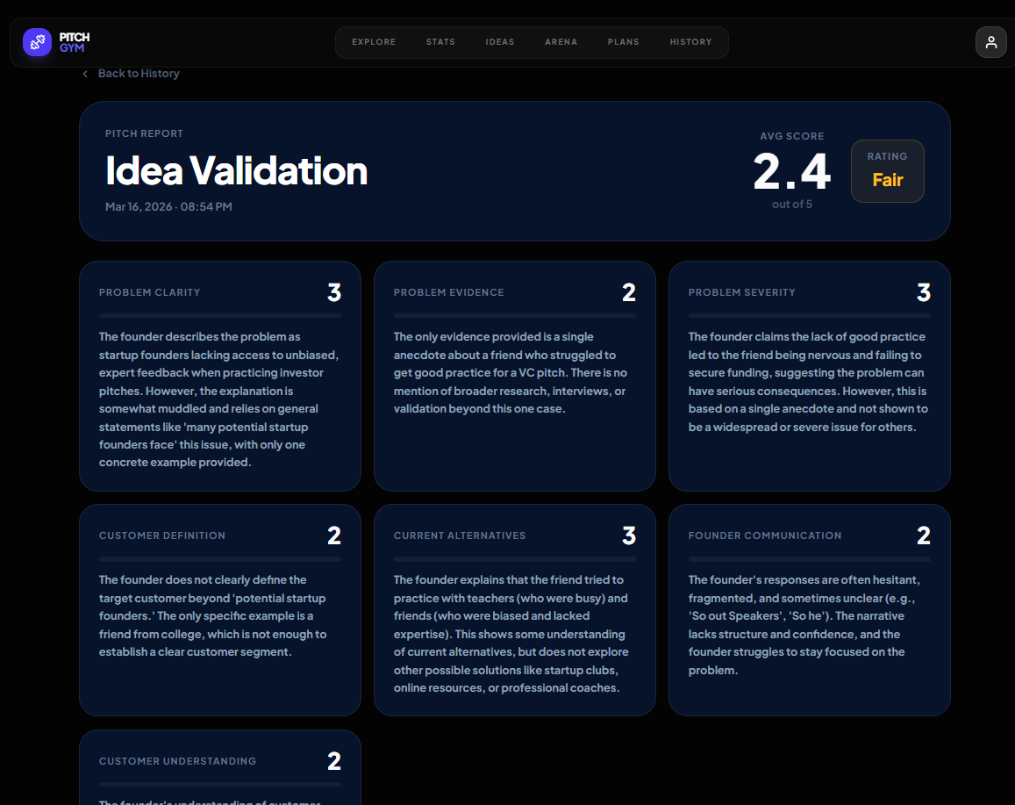
STRUCTURED ASSESSMENT
At the end of each conversation, the AI generates a structured JSON assessment:
Per-category scores (1–5) with detailed analysis for each metric
Overall rating: Excellent, Good, Fair, or Poor
Strengths: what the founder did well
Weaknesses: areas needing improvement
Biggest concern: the most critical issue to address
Improvement suggestions: actionable next steps
Call recording: For playback analysis
Transcript: For future reference

Slide 12
CONTEXT CARRY FORWARD
Founder selects an idea from their Idea Bank
System queries up to 10 previous pitch sessions for that idea
Founder picks a prior session: system extracts a condensed summary (rating, strengths, weaknesses) capped at 1,500 characters
Summary is injected into the AI's system prompt via Vapi template variable substitution
AI investor acknowledges prior performance
Each session is informed by past feedback, creating a realistic coaching progression.

Slide 13
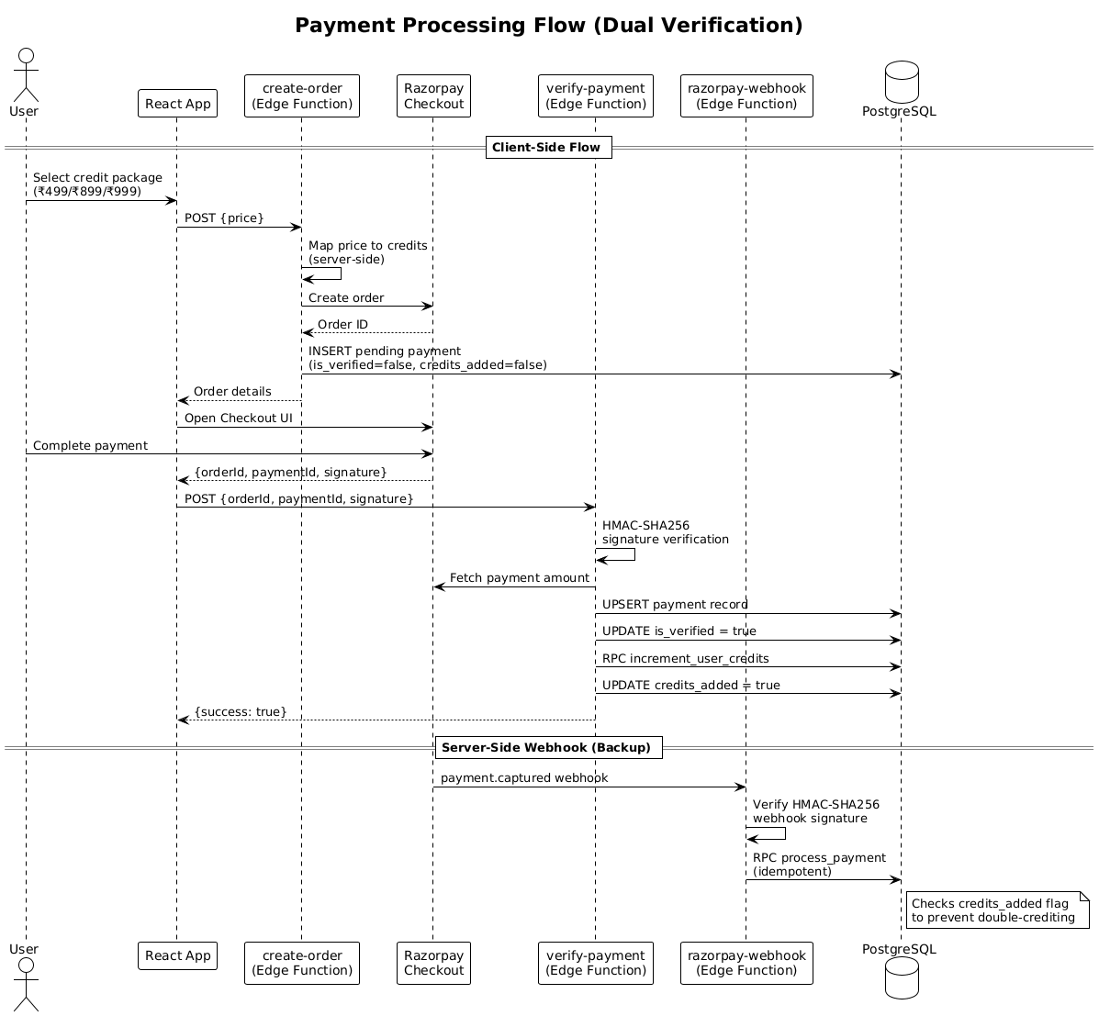
PAYMENT AND CREDIT SYSTEM
Three credit packages
Server-side price-to-credit mapping in Edge Function prevents client-side price manipulation
Client path: Razorpay Checkout → verify-payment Edge Function → HMAC-SHA256 signature check → add credits
Both paths are idempotent: credits_added flag per payment prevents double-crediting
Fractional credit deduction based on actual call duration

Slide 14
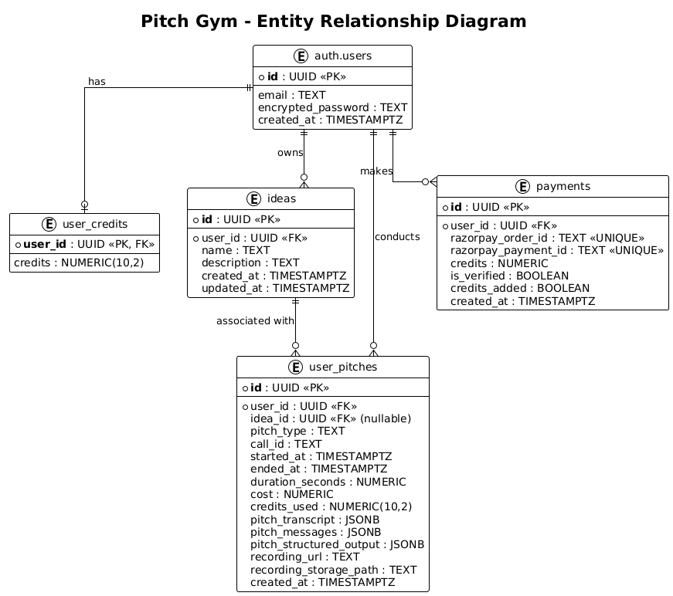
DATABASE SCHEMA
auth.users: Supabase-managed authentication (email/password + Google OAuth)
user_credits: Credit balance stored as numeric(10,2)
user_pitches: Session data including transcript, structured JSON assessment, recording URL, duration
payments — Razorpay order tracking with is_verified and credits_added flags for idempotency
ideas — Founder's startup ideas for grouping sessions and enabling context carry-forward

Slide 15
TECHNOLOGY STACK
Layer | Technology | Purpose
Frontend | React 19 + Vite 7 | Component-based SPA
Styling | Tailwind CSS | CSS Styling Standard
Charts | Recharts | Score trends, skill radar, pitch type distribution
Backend | Supabase | PostgreSQL, Auth, Edge Functions, Storage: full BaaS
Voice AI Agent | Vapi AI | WebRTC-based real-time audio streaming
LLM Model (Vapi AI) | OpenAI GPT-4o | LLM powering investor persona behavior
Speech (Vapi AI) | Deepgram (STT) + ElevenLabs (TTS) | Speech recognition and voice synthesis
Payments | Razorpay | Credit purchase

Slide 16
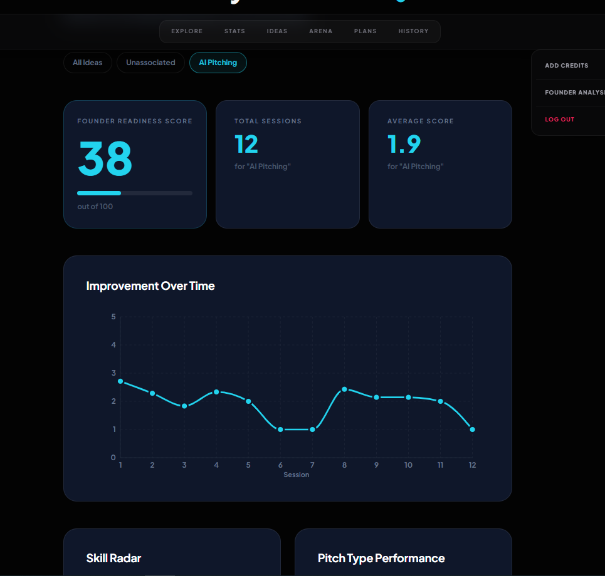
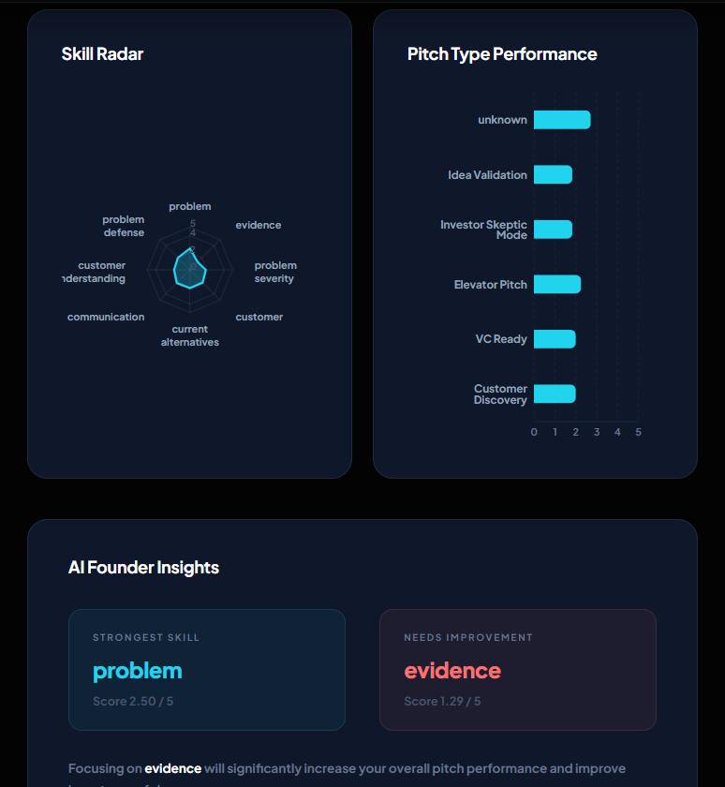
ANALYTICS DASHBOARD

Slide 17
TESTING
Unit Tests (Vitest) — 52 tests, all passed in 1.30s:
pitchParser.js (32 tests): JSON parsing, repair, assessment key extraction, score computation, rating styles, end-to-end pipelines
pitchAnalytics.js (15 tests): Score extraction, average calculation, rating color mapping, null handling
pitchContext.js (5 tests): Context string building, truncation at 1500 chars, edge cases with missing data
Integration Testing:
OAuth login flows, payment processing (order creation, signature verification, webhook delivery), Vapi proxy authentication and credit checks
User Acceptance Testing:
End-to-end pitch sessions conducted across all 10 pitch types, verifying the full flow from selection through assessment display

Slide 18
RESULTS
Functional Flows: The end-to-end pitch flow is fully operational: from type selection and voice conversation through to structured assessment with scores and feedback. The analytics dashboard successfully renders score trends, skill radar, and pitch type distribution with idea-level filtering. Authentication works seamlessly with both email/password and Google OAuth including session persistence and route guarding.
Payment & Credit System: Dual-verification architecture processed all test transactions without any double-crediting. Fractional credit deduction accurately tracked per-minute usage across sessions of varying lengths.
Scoring Behavior: The AI appropriately differentiated difficulty levels — easier types like Customer Discovery (3.5/5) and Co-Founder Pitch (3.6/5) scored higher than harder types like VC Ready (2.8/5) and Investor Skeptic Mode (2.5/5).
Context Carry-Forward: When sessions included prior context, the AI acknowledged previous feedback and incorporated it into the conversation with targeted follow-up questions based on the founder's earlier performance.
Testing: 52/52 unit tests passing. Integration and UAT validated all flows across all 10 pitch types.

Slide 19
CONCLUSION
Pitch Gym proves that AI-powered voice interaction can serve as a alternative to traditional pitch coaching for startup founders
The platform makes structured pitch training accessible, affordable, and available on-demand, therefore removing barriers of cost, geography, and scheduling
Founders receive consistent, quantitative and actionable feedback that enables measurable improvement over time
The project demonstrates a practical integration of multiple emerging technologies (voice AI, LLMs, real-time audio, serverless computing) into a cohesive product
The approach is generalizable beyond startup pitching: the same framework could be adapted for sales training, job interview preparation, public speaking coaching, or academic viva practice
With the rise of AI agents, platforms like Pitch Gym represent a shift toward interactive, skill-based AI training tools that go beyond passive video watching to gain knowledge and practical experience

Slide 20
FUTURE ENHANCEMENTS
Fine-tuned scoring models: train on accumulated data for more accurate, calibrated assessments
Video-based delivery analysis: analyze body language, eye contact, and facial expressions via webcam
Peer comparison leaderboards: benchmarking against other founders at similar stages
Multi-language support: enable pitch practice in Hindi, Spanish, Mandarin, and other languages
Mobile application: React Native port for mobile practice
Group pitch mode: simulate panel interviews with multiple AI investors asking questions simultaneously

Slide 21
REFERENCES
Brooks, A.W. et al. (2014). "Pitch Perfect: Examining the Effect of Founder-Investor Fit in Venture Pitches." Management Science, 60(1), 116–134. https://doi.org/10.1287/mnsc.2013.1755.
Brown, T. et al. (2020). "Language Models are Few-Shot Learners." NeurIPS, 33, 1877–1901. https://arxiv.org/abs/2005.14165.
Radford, A. et al. (2023). "Robust Speech Recognition via Large-Scale Weak Supervision." ICML, 202, 28492–28518. https://arxiv.org/abs/2212.04356.
Sredojev, S. et al. (2015). "WebRTC Technology Overview and Signaling Solution Design." MIPRO 2015, IEEE, 1006–1009. https://doi.org/10.1109/MIPRO.2015.7160422.
Zawacki-Richter, O. et al. (2019). "Systematic Review of Research on AI Applications in Higher Education." Int. J. Educational Technology in Higher Education, 16(1), 1–27. https://doi.org/10.1186/s41239-019-0171-0.
Ouyang, L. et al. (2022). "Training Language Models to Follow Instructions with Human Feedback." NeurIPS, 35, 27730–27744. https://arxiv.org/abs/2203.02155.
Jonas, E. et al. (2019). "Cloud Programming Simplified: A Berkeley View on Serverless Computing." arXiv preprint. https://arxiv.org/abs/1902.03383.

Slide 22
ACKNOWLEDGEMENTS
I would like to extend my sincerest gratitude to VIT University for providing the platform and resources that have made this project possible. My thanks also go to the School of Computer Science and Engineering(SCOPE) for its unwavering support and guidance throughout our academic journey.
A special and heartfelt thank you to my guide, Dr Sarwesh P. Your invaluable guidance, expert knowledge, and continuous encouragement have been critical to the progress of our work so far. We are truly grateful for the time and effort you have dedicated to mentoring our team.

Slide 23

THANK YOU!!!

